Slide 1
Building a “New” Program

Slide 2
It Begins with You

Slide 3
Are you Balanced?
You are a facilitator of goals for others – what about for yourself?
Goals for all aspects of your life

Slide 4
What is important to you?
Prioritize your list.
Identify your Roles (spouse, parent, provider, athlete, citizen etc.)

Slide 5
S.M.A.R.T. Goals part 1
Specific: the goal must clearly state WHAT is to be achieved, by WHOM, WHERE, and WHEN it is to be achieved
Measureable: applies to both the end result and the milestones along the way

Slide 6
S.M.A.R.T. Goals part 2
Achievable: you must believe that you can manage to do what you are setting out to do
Relevant: do those things that are most important and in line with your long term vision and mission (short and long term goals)

Slide 7
S.M.A.R.T. Goals part 3
Time-based: put a time-frame to your goals

Slide 8
Core Values
Core values are those values we hold which form the foundation of our team; they frame the way we:
Articulate what we stand for
Perform our work
Conduct ourselves
Govern our relationships
Guide our decisions

Slide 9
What are the Core Values of your Program?
What do you want the young people to look like when they leave your program?
Identify your team core values
Define your team core values

Slide 10
Inside Out Coaching
Joe Ehrmann
It is a book that I hope will encourage and challenge you to turn your struggles, errors and misfortunes into lessons that will make you a coach who instills a sense of community; is a better classroom leader; a clearer and more empathetic communicator; an advocate of healthy and constructive competition and a mentor who turns sports into a ceremony of celebration for young people.

Slide 11
Creating a Season Packet
Step 1: Vision
What are our beliefs?
What is our preferred future?
How has the job market changed?
What have we done to prepare our athletes in this world?

Slide 12
Step 2: Mission
identify “winning ideas”
Identify core values of success
Combine the winning ideas and core values into a tangible and measurable goal
Refine the words until you have a concise and precise statement of your mission

Slide 13
Step 3: Team Goals
Academic
Athletic
Community

Slide 14
Keeping it Fun!
Specialty Workouts

Slide 15
Lap after Lap
Day after Day
Can lead to boredom and reduce performance and focus

Slide 16
Have Fun …
Be Creative…
Mix it up
Use your imagination…beg, borrow or “steal” from others

Slide 17
100 x 100
A real challenge
On a specified interval or varied sets

Slide 18
Dartboard Workout
Magnetic Dartboard
6 darts
Each area of the board is 1000 yard set
Bull’s Eye wins a trip home after warm-up

Slide 19
The 12 Days of Christmas
Patterned after the song
Over 9000 yards

Slide 20
Santa’s Stocking
Swimmers and divers draw slips of paper from a Christmas stocking
Whatever is drawn is done
Mix of “fun stuff” and challenges

Slide 21
Greeting Card Workout
Written by the swimmers and divers for a teammate
Parameters set by coaching staff
Any holiday card will do
We do it over winter break and for St. Patrick’s Day

Slide 22
Candy Cane Relays
Workout, after warm-up, is totally relays
Winners of each relay race earn candy canes

Slide 23
Stotan Week
Stotan Contract
Specialty workouts like in the book
Swimmers read the book, STOTAN by Chris Crutcher
Special certificates/shirts at end of week

Slide 24
Circuit Day
Opportunity to use the equipment
The swimmers love the “toys”

Slide 25
Swimming in the Dark
Glow sticks on ends of pool
Glow bracelets on hands

Slide 26
Stop and Go Kicking
Coach or swimmer determines when to “stop” and when to “go” on the kick set
Stop means easy kicking
Set a time limit for the set
Mix up the times

Slide 27
PI Day
Held on March 14 (Spring Season for girls)
Take PI out to 8 – 10 decimal places with each set being determined by the place value

Slide 28
50’s to Failure and 100’s to Success
Send-off chart for 50’s
Swim until you miss an interval
Repeat 100’s working for perfection – slow, fast, etc.

Slide 29
Random Numbers
Pick random numbers → number of repeats in a set or move to that lane, etc.

Slide 30
Countdown to Championships
Post number of days left until championships (conference, regionals, state) each day
Focus on getting work done now for later

Slide 31
Specialty Taper Countdown
Behind the 8 Ball
Lucky Seven
The Three Musketeers (All for One and One for All)
FOURtitude
Five Card Stud

Slide 32
Circus Peanuts and
Swedish Fish
NOT A SET BUT BREAKS UP THE PRACTICE – A TREAT
Quick energy
Like feeding the
animals at the zoo

Slide 33
Your Turn
What special sets do you do to keep things interesting?

Slide 34
Building the Team Concept

Slide 35
The Team Concept
High school swimming and diving is unique because of TEAM.
Strengthen the TEAM Concept to develop a strong, cohesive unit.
Guide your athletes to know one another → support for one another
Set guidelines for practice and meet conduct, atmosphere, and effort in one way to start.

Slide 36

Swimmers and Divers must be taught the expectations of a program and the coaching staff
We cannot expect them to meet our expectations if they do not know those expectations.

Slide 37
Swimmer Evaluation Chart
Swimming Factors | Far Exceeds Requirements | Exceeds Requirements | Meets Requirements | Needs Some Improvement | Well???
Speed | Is faster than a speeding bullet | Is as fast as a speeding bullet | Not quite as fast as a speeding bullet | Would you believe a slow bullet? | Wounds self with bullets when trying to shoot guns
Stroke Knowledge | Talks with the gods | Talks with coaches | Talks with himself | Argues with himself | Loses those arguments
Positive Mental Attitude | Is stronger than a locomotive | Is stronger than a bull elephant | Is stronger than a bull | Shoots the bull | Smells like a bull
Strong Finish | Walks on water always | Walks on water in emergencies | Washes with water | Drinks water | Passes water in emergencies
Start | Leaps 50 meter pools in a single bound | Leaps 25 yard pools in a single bound | Leaps into water | Stumbles over starting blocks | Never reports to the clerk of the course

Slide 38
Team Expectation Rubrics
Practice Effort Rubric
Practice Etiquette Rubric
Meet Day Evaluation Rubric

Slide 39
Swimming Set Exams
Like learning the playbook for other sports, swimmers need to know the sets we have them swim each day.
It saves time and promotes better effort if they know what they are doing and WHY they are doing each set.

Slide 40
Teambuilding
Teambuilding activities are one way to help develop the TEAM Concept.
Some require great feats of skill. Some require problem solving skills. Some require “thinking outside of the bowl.” All require group participation and cooperation.
There are many activities that will accomplish the desired outcome. A few examples follow (included in your handouts).

Slide 41
The Hello Game
A game devised by Lanny Landtroop
The purpose is to prepare swimmers for practice as they enter the door of the pool.
Can be played outside of the pool setting as well.

Slide 42

Camera Activity
Select a teammate’s name
Use a single use camera or camera phone
Secretly take pictures of your teammate throughout the season
Prepare a “presentation” for the
pre-championship dinner

Slide 43
Previous Examples of Presentations
Posters
Poetry
Video DVD
Photo album
Photo box

Slide 44
Scavenger Hunt
Photo scavenger hunt
Teams divided into groups
Set a time limit
Recognize the ‘winning team”
Post the pictures for all to see
I do this at the end of the first week of practice
Team meets for dinner afterwards

Slide 45
Up All Night
Similar to college basketball season opening
Teambuilding activities
Midnight workout
Workshops on nutrition, dryland, etc.
Team activities (t-shirt design, season theme, pre-meet music)
Team breakfast

Slide 46
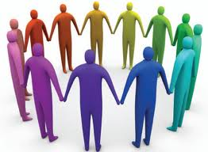
Before or After Practice Examples
Human Knot
The Box

Slide 47
Progressive Dinner
Typical progressive dinner format
Teambuilding activity at each location

Slide 48

Sports Psychology

Slide 49
Concepts of the Week
Themes or “concepts” for each week of the season
Quotes posted and discussed daily to tie into the week’s theme
Each week builds into the following week

Slide 50
Examples
Focusing your Attention
Expectations
Relaxation
Confidence
Happy but Never Satisfied
Teamwork
Technical Excellence
Effort
Positive Thinking
Sportsmanship
Beginning to Visualize
Consistency
Dealing with Adversity

Slide 51
Happy but Never Satisfied
Develop a burning desire to reach your goals. Visualize then as though they were already true
You can’t win today on what you did in the last race.
Be satisfied with nothing but your best.
Winners see what they can become rater than what they are.
Goal Setting

Slide 52
Workout Logs
Daily training logs to record accomplishments and struggles as well as daily and weekly goals
Concept of the Week is recorded on the logs as well

Slide 53
My Road Map
Log of events, times/scores, goals, ultimate goals, current time/score

Slide 54
Daily Talks
5-10 minute talks dealing with positive thinking, goals, imagery, self-belief
We do our while we are stretching

Slide 55
Reading to Motivate
Challenge athletes to read books dealing with a swimming or diving challenge/struggle/accomplishment

Slide 56
Goal Setting Activities

Slide 57
Examples
Identifying your Goals
Setting Realistic Goals
Goal Setting by Dr. Daniel Carl
The Swim to Win Playbook
Setting Goals to Win
Setting Weekly and Daily Goals
Twelve Characteristics of Good Goals

Slide 58
Thinking Outside the Bowl

Slide 59
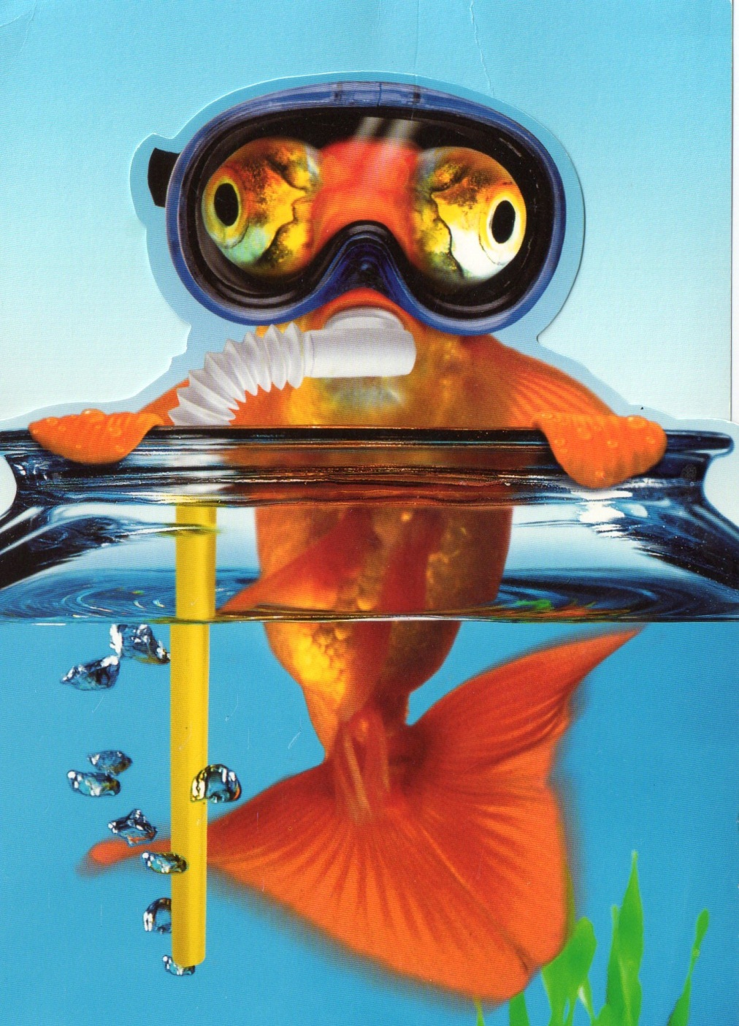

Slide 60

Hand-Held Devices
Hand-held phones which record
I Pads
I Phones
Hand-held projectors
All can show video and many can record

Slide 61
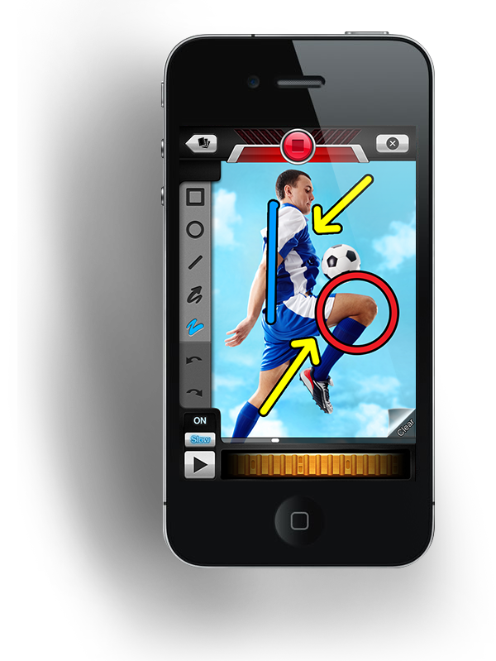
Coach’s Eye
App for I Phones and I Pads
$4.99
Video drawing tools
Video review with voiceover
Frame-by-frame motion analysis
Instant sharing

Slide 62
Coaches’ Eye video on YouTube

Slide 63
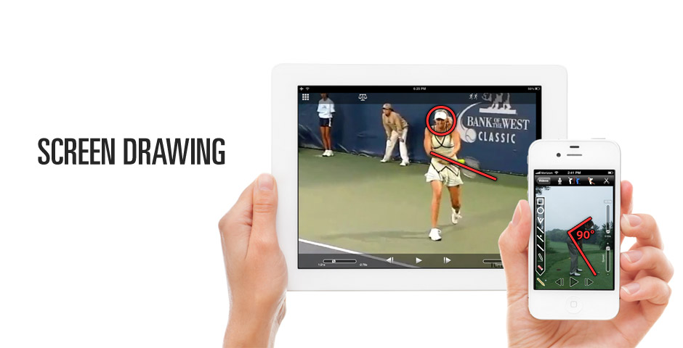
Ubersense
Free personal coach

Slide 64
Underwater Cameras
Swimmers love being filmed
Can analyze strokes from a different angle

Slide 65
Swim Times
Free App
Converts times from short course yards, short course meters, and long course meters to the other pool types

Slide 66
Standard Swim
Free App
Animated video of strokes

Slide 67
Swim Log
$4.99 App
Tracks swim times

Slide 68
Go Swim
Free App
Free drills, swimming news, fan wall

Slide 69
Swim Speeds
Free App
Calculator to determine swim distance, time, pace, and speed quickly and easily
Logs workouts
Calorie calculation
Log heart rate information

Slide 70
SwimLabs
Free App
Library of swimming technical video

Slide 71
uCoach
$1.99 App
Record split/lap times for multiple athletes simultaneously
Organizes date by meet and event
Instantly email meet results in spreadsheet format

Slide 72
Swimulator+
Free App
Swim speed calculator for use with FINIS Tempo Trainer Pro

Slide 73
Dive Meet Manager
$3.99 App
Keep scores for diving
Track multiple divers
Post scores
Search past meets

Slide 74
Free Books
Free Books online
  Swimming Scientifically Taught: A Practical Manual for Young and Old
  Selected Works: A Thimble, Half Full and other Toughts on Swimming
  (Clive Rushton)

